Slide 1
CT026-3.5-2
Human Computer Interaction
Human Computer Interaction
Overview
Level 2
Prepared by: RHR First Prepared on: December, 2007 Last Modified on:
Quality checked by: MOH
Copyright 2004 Asia Pacific Institute of Information Technology

Slide 2
Topic & Structure of the lesson
Understanding user
Human factors
  Physiology
  Cognition
  Perception
Metaphors
Stakeholders

Slide 3
Learning Outcomes
At the end of this lecture, you should be able to:
  Identify the user perception on the interface layouts
  Describe the cognitive psychology, and metaphor concepts
  Identify the stakeholder of the system designed to guide the user requirements and evaluation

Slide 4
Key Terms you must be able to use
If you have mastered this topic, you should be able to use the following terms correctly in your assignments and exams:
Metaphors
Stakeholder

Slide 5
Understanding Users
System User
  Individual user, a group of users working together or a sequence of user in organization each dealing with some part of the task or process.
  Hint: Users are limited in their capacity to process information

Slide 6
Understanding Users
In order to design, it is important to understand the capabilities and limitations of those we are designing for.

Slide 7
Human Factors
We look at the human factors that affect how
people interact with computers and computer
programs:
Physiology - physical make-up, capabilities
Cognition - thinking, reasoning, problem-solving, memory
Perception - how a person perceives what input they get through their senses

Slide 8
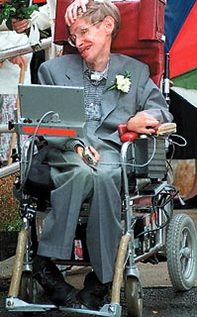
Human Factors : Physiology
The design of devices are often affected by the human physiology
Some constraints can be introduced and applied based on the physical built up of the users
Example:
Keyboard keys cannot be smaller than finger size.
Smaller machines must use different input facilities.
Toilet for toddlers
Specific door widths and heights

Slide 9

Human Factors : Physiology: Reaction Time
Human reaction times:
Audio signal - 150ms
Visual signal - 200ms
Pain - 700ms
Examples of use:
Design of video games
Traffic lights
Phone

Slide 10

Human Factors : Physiology: Movement
Speed of accuracy of movement important for interactive
systems.
Examples:
Mouse - keyboard movement (affects choice of which devices/controls operate which actions of the system)
Time taken to move to a target on screen
Careful arrangement of menu items so that frequent choices are placed first

Slide 11
Human Factors : Physiology: Disabilities
Designers must design so that disabled users can
achieve maximum functionality and usability from
computer systems
Also devices to assist disabled users:
Speech input and output systems (useful for blind people and those with severe motor impairment)
Keyboard pressing devices
Eye movement detection devices

Slide 12
Human Factors : Cognition
The processes by which we become acquainted with things, how we gain knowledge, familiarity
What goes in our heads when we carry out our everyday activities
Involves understanding, thinking, remembering, reasoning, memorizing, attending, awareness, acquiring skills, creating new ideas.

Slide 13
Human factors : Cognition
  Managing Attention
    Process of selecting things to concentrate on at a point in time
    Depends on:
      Users’ goals
        If we know exactly what we want to find out, we try to match this with the information that is available
      Information presentation
        Greatly influence how easy or difficult it is to digest appropriate pieces of information

Slide 14
Human factors : Cognition
Interface designers need to focus attention on the
right place:
Users’ goals
Try to read the sentences below…
Everyday my sister goes to shoocl
My two cats lvoe fish
I am a Sfrodatifhrse University graduate
They are sudtying at the UCTI

Slide 15
Human factors : Cognition
Try to read the paragraph below…
According to a rscheearch at Cmabrigde Uinervtisy, it deosn't mttaer in waht oredr the ltteers in a wrod are, the olny iprmoetnt tihng is taht the frist and lsat ltteer be at the rghit pclae. The rset can be a total mses and you can sitll raed it wouthit porbelm. Tihs is bcuseae the huamn mnid deos not raed ervey lteter by istlef, but the wrod as a wlohe and the biran fguiers it out aynawy.
How do you explain being able to read this?

Slide 16
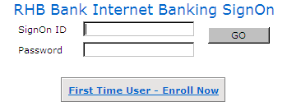
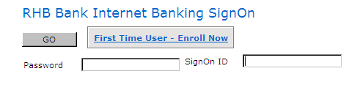
Human factors : Cognition
Interface designers need to focus attention on the
right place:
Structured information
VS

Slide 17
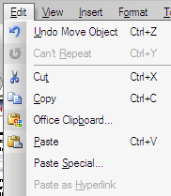
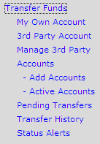
Human factors : Cognition
Interface designers need to focus attention on the
right place:
Information grouped into meaningful parts

Slide 18
Human factors : Cognition
Interface designers need to focus attention on the
right place:
Amount of information presented not too much/little
Read the lists in the next slide, cover it up, and then try to recall as many of the items as possible

Slide 19
Human factors : Cognition
3, 12, 6, 20, 15, 49, 81, 76, 8, 97, 13, 56
Cat, house, paper, laugh, people, red, yes, number, shadow, broom, rain, plant, lamp, chocolate, radio, one, coin
T, k, y, w, n, o, c, d, e, q, p, r

Slide 20
Human factors : Cognition
According to George Miller’s (1956) theory, 7 ± 2 chunks of information can be held in short – term memory at any time.
How to apply this in interface design?

Slide 21
Human factors : Cognition
Design tips…
  Have only 7 options on a menu
  Display only 7 icons on a menu bar
  Place only 7 items on a pull down menu

Slide 22
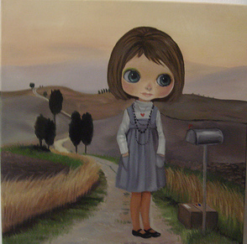
Human factors : Perception
How a person perceives what input they get through their senses
Capabilities and limitation of visual processing and understand how we perceive size and depth, brightness and colour

Slide 23
Human Factors : Perception
Input from the different senses
Auditory Perception
Haptic (Touch) Perception
Visual Perception
We need to understand how the input information
Is perceived by humans.

Slide 24

Human factors - Perception
Notes:
What can you see, ask each student

Slide 25
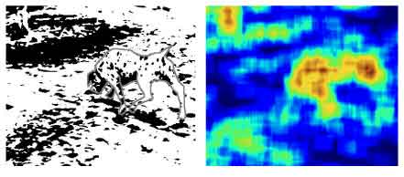
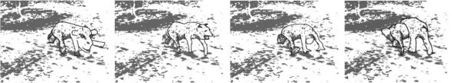
Human factors - Perception

Slide 26

Human factors - Perception

Slide 27
Metaphors
A conceptual model that has been developed to be similar in some way to the aspects of a physical entity.
Maps elements of the real world on to elements of the system world
Dragging a document icon across the desktop screen was seen as equivalent to picking up a piece of paper in the physical world and moving it.

Slide 28
Metaphors
Benefits of using metaphors
  Easier to learn because it is familiar to user
  Enables learning by building upon existing knowledge
  Provide a powerful way of learning the complexity of a system
  A short cut to complete concepts

Slide 29
Cultural and International Issues
Beware of using text or alphabetic characters inside an icon. Different language versions of the icon will probably be needed. (e.g. H for home, H for help)
Hand symbols, facial appearances, etc. vary immensely from culture to culture! Don’t use them in icons. (may be offensive)
Beware also of metaphors dependent on a particular culture, for example the US mailbox for incoming mail. (Each country’s mailbox looks different)

Slide 30
Metaphors - Recognition & Recall
Where possible, choose a metaphor familiar to the viewer.
Use concrete objects wherever possible, abstract concepts and actions are difficult to visualise. (e.g. water tap with water drop instead of a river to represent water)
Provide textual labels (tooltips)

Slide 31
2nd Tutorial- In a group of 3, finish up this and submit
Question 1
You are required to develop an Education Learning System known as “Learnfinity” for your campus. This system will be used mainly by students and lecturers in order to facilitate communication between them. In the system, users can access to the notes, timetable, news, announcement and etc. Lecturers mainly are using the system to upload all the learning material to be accessed by the student.
Describe in detail the human factors that need to be considered and taken into account when developing such system and why do you think it is important to think about the human factors mentioned.
(20 marks)
Select and explain TWO (2) iconic metaphors that you would use for this Learnfinity system. Justify why you have selected the metaphors.
(10 marks)

Slide 32
Stakeholder
Defined as anyone who is affected by the success and the failure of the system

Slide 33
Categories of Stakeholder
Primary
  Those who use the system
Secondary
  Those who don’t directly use the system but receive the output from it
    Someone who receive reports from the system

Slide 34
Categories of Stakeholder
Tertiary
  Those who do not fall into 1 and 2 but who are affected by the success or failure of the system
    A director whose profit increase or decrease depending on the success of the system

Slide 35
Categories of Stakeholder
Facilitating
  Those who are involved in designing, developing and maintaining the system

Slide 36
Classifying stakeholders
Classifying stakeholders - An Airline Booking System
“An international airline is considering introducing a new booking system for use by associated travel agents to sell flights directly to the public”

Slide 37
Classifying stakeholders
Primary Stakeholders
  Travel Agency staff, airline booking staff
Secondary Stakeholders
  Customers, Airline management
Tertiary Stakeholders
  Competitors, Civil aviation authorities, Airline Shareholders
Facilitating Stakeholders
  Design team, IT Department staff

Slide 38
Review question
Classifying stakeholders from APIIT Online Library system

Slide 39
Summary of Main Teaching Points
We must understand what is the strength and limitation of a user before we start to design any system.
A good system will be able to increase the effectiveness and efficiency of users and is able to accommodate a wide range of user

Slide 40
Question and Answer Session
Q & A

Slide 41
Next Session
Topic and Structure of next session
Design Principles
Notes:
Proceed with giving the students the task for their second tutorial (finding badly design product) as they are to present their work in the next tutorial session

